Slide 1
The treatment of intracranial meningiomas is microneurosurgery
Luciano Mastronadi
1. Head of Department of Surgical Specialities, ASLRoma1
2. Chief of the Division of Neurosurgery, SFN Hospital
3. Professor of Neurosurgery, Sechenov 1° Medical State University, Moscow
www.neurologiachirurgica.it
1
UOC Neurochirurgia
mastronardinch@gmail.com

Slide 2
41yo lady, lawyer, perfect health conditions
Small left tentorial/basal temporal meningioma (occasional finding)
To treat or not to treat?

Slide 3
History
May 2018: Asymptomatic (slight headache). First MRI: left basal temporal meningioma, starting from upper surface of tentorium, with maximum diameter of about 3 cm. Neurosurgeon suggested to wait and scan.
April 2019: A second MRI showed a doubtful increase of tumor. She was treated with Gamma-knife in Milano.
October 2019: MRI 6 months after GK showed slight volumetric increase of tumor size and marked edema of left temporal lobe, not present previously. After GK, she had continuous and debilitating headache.
November 2019: microneurosurgery and total removal of tumor (SFN, Roma). Histology: fibrous meningioma (WHO I)

Slide 4
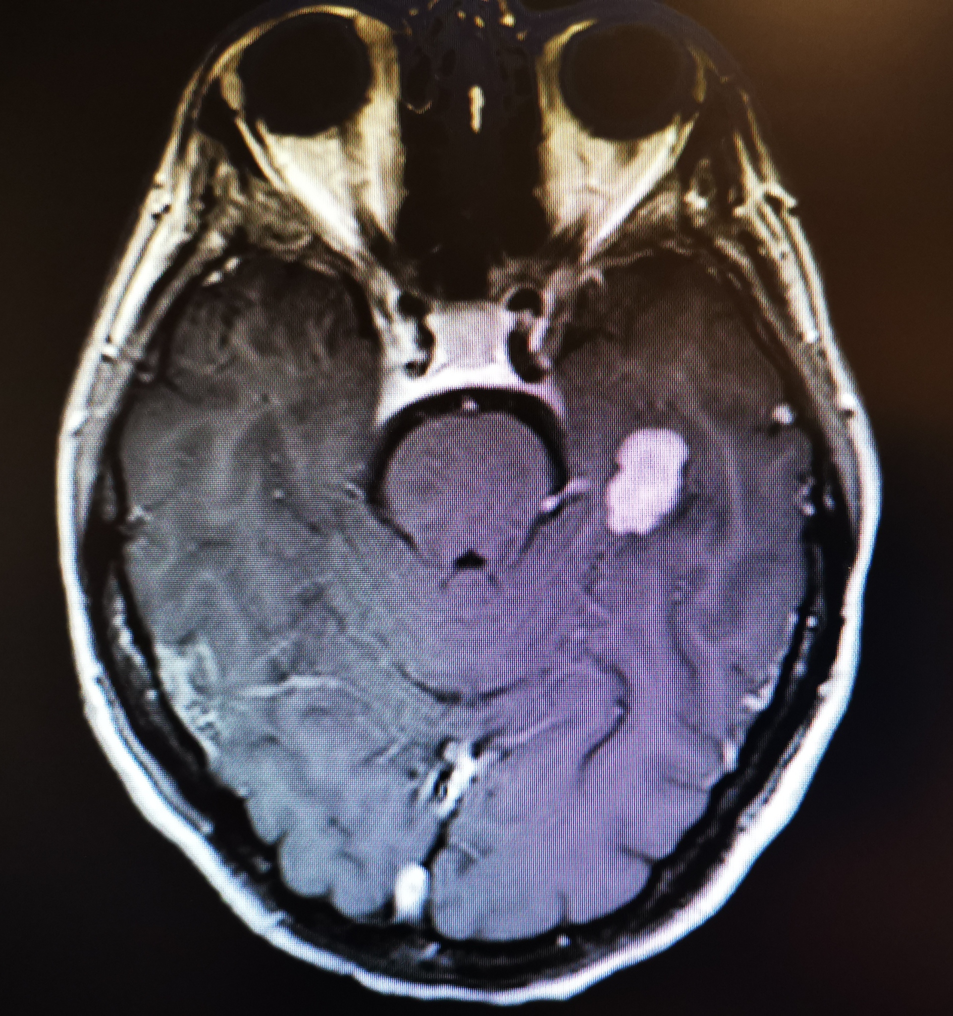
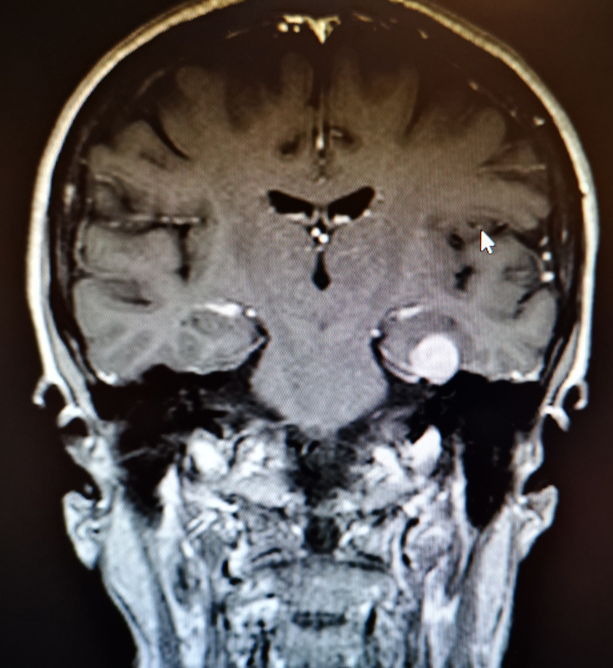
First MRI (May 2018)

Slide 5
April 2019
Gamma-knife in Milano
Afterthat: continuous headache

Slide 6
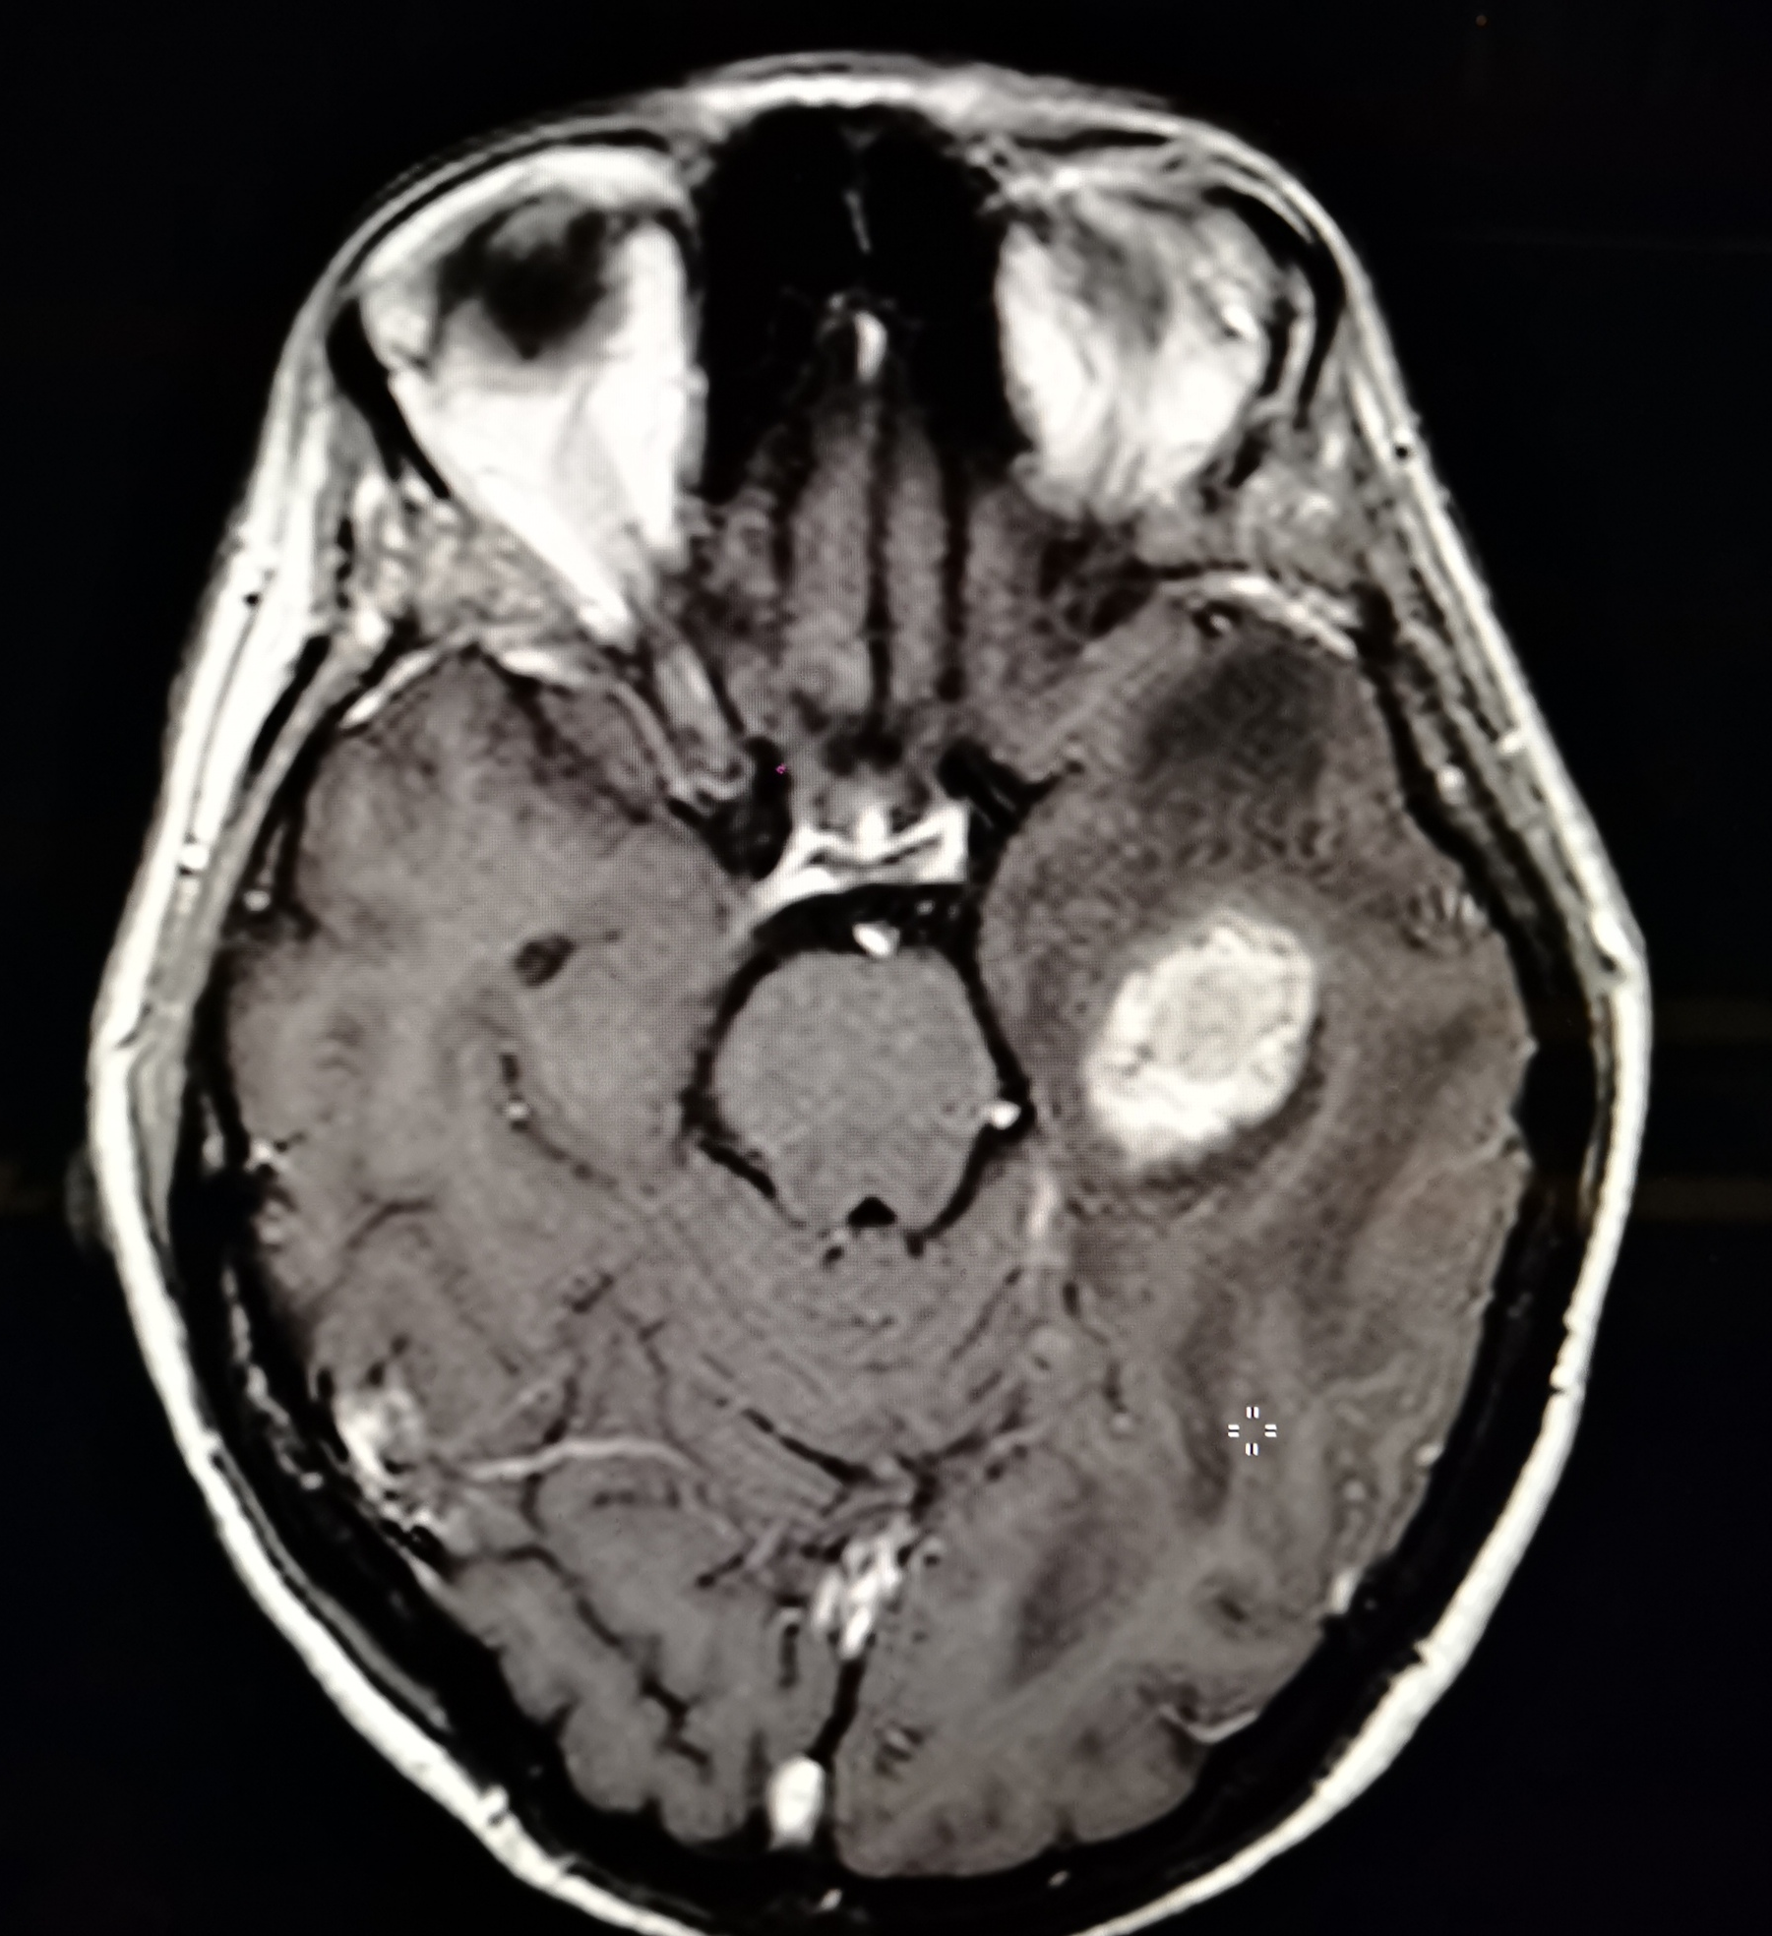
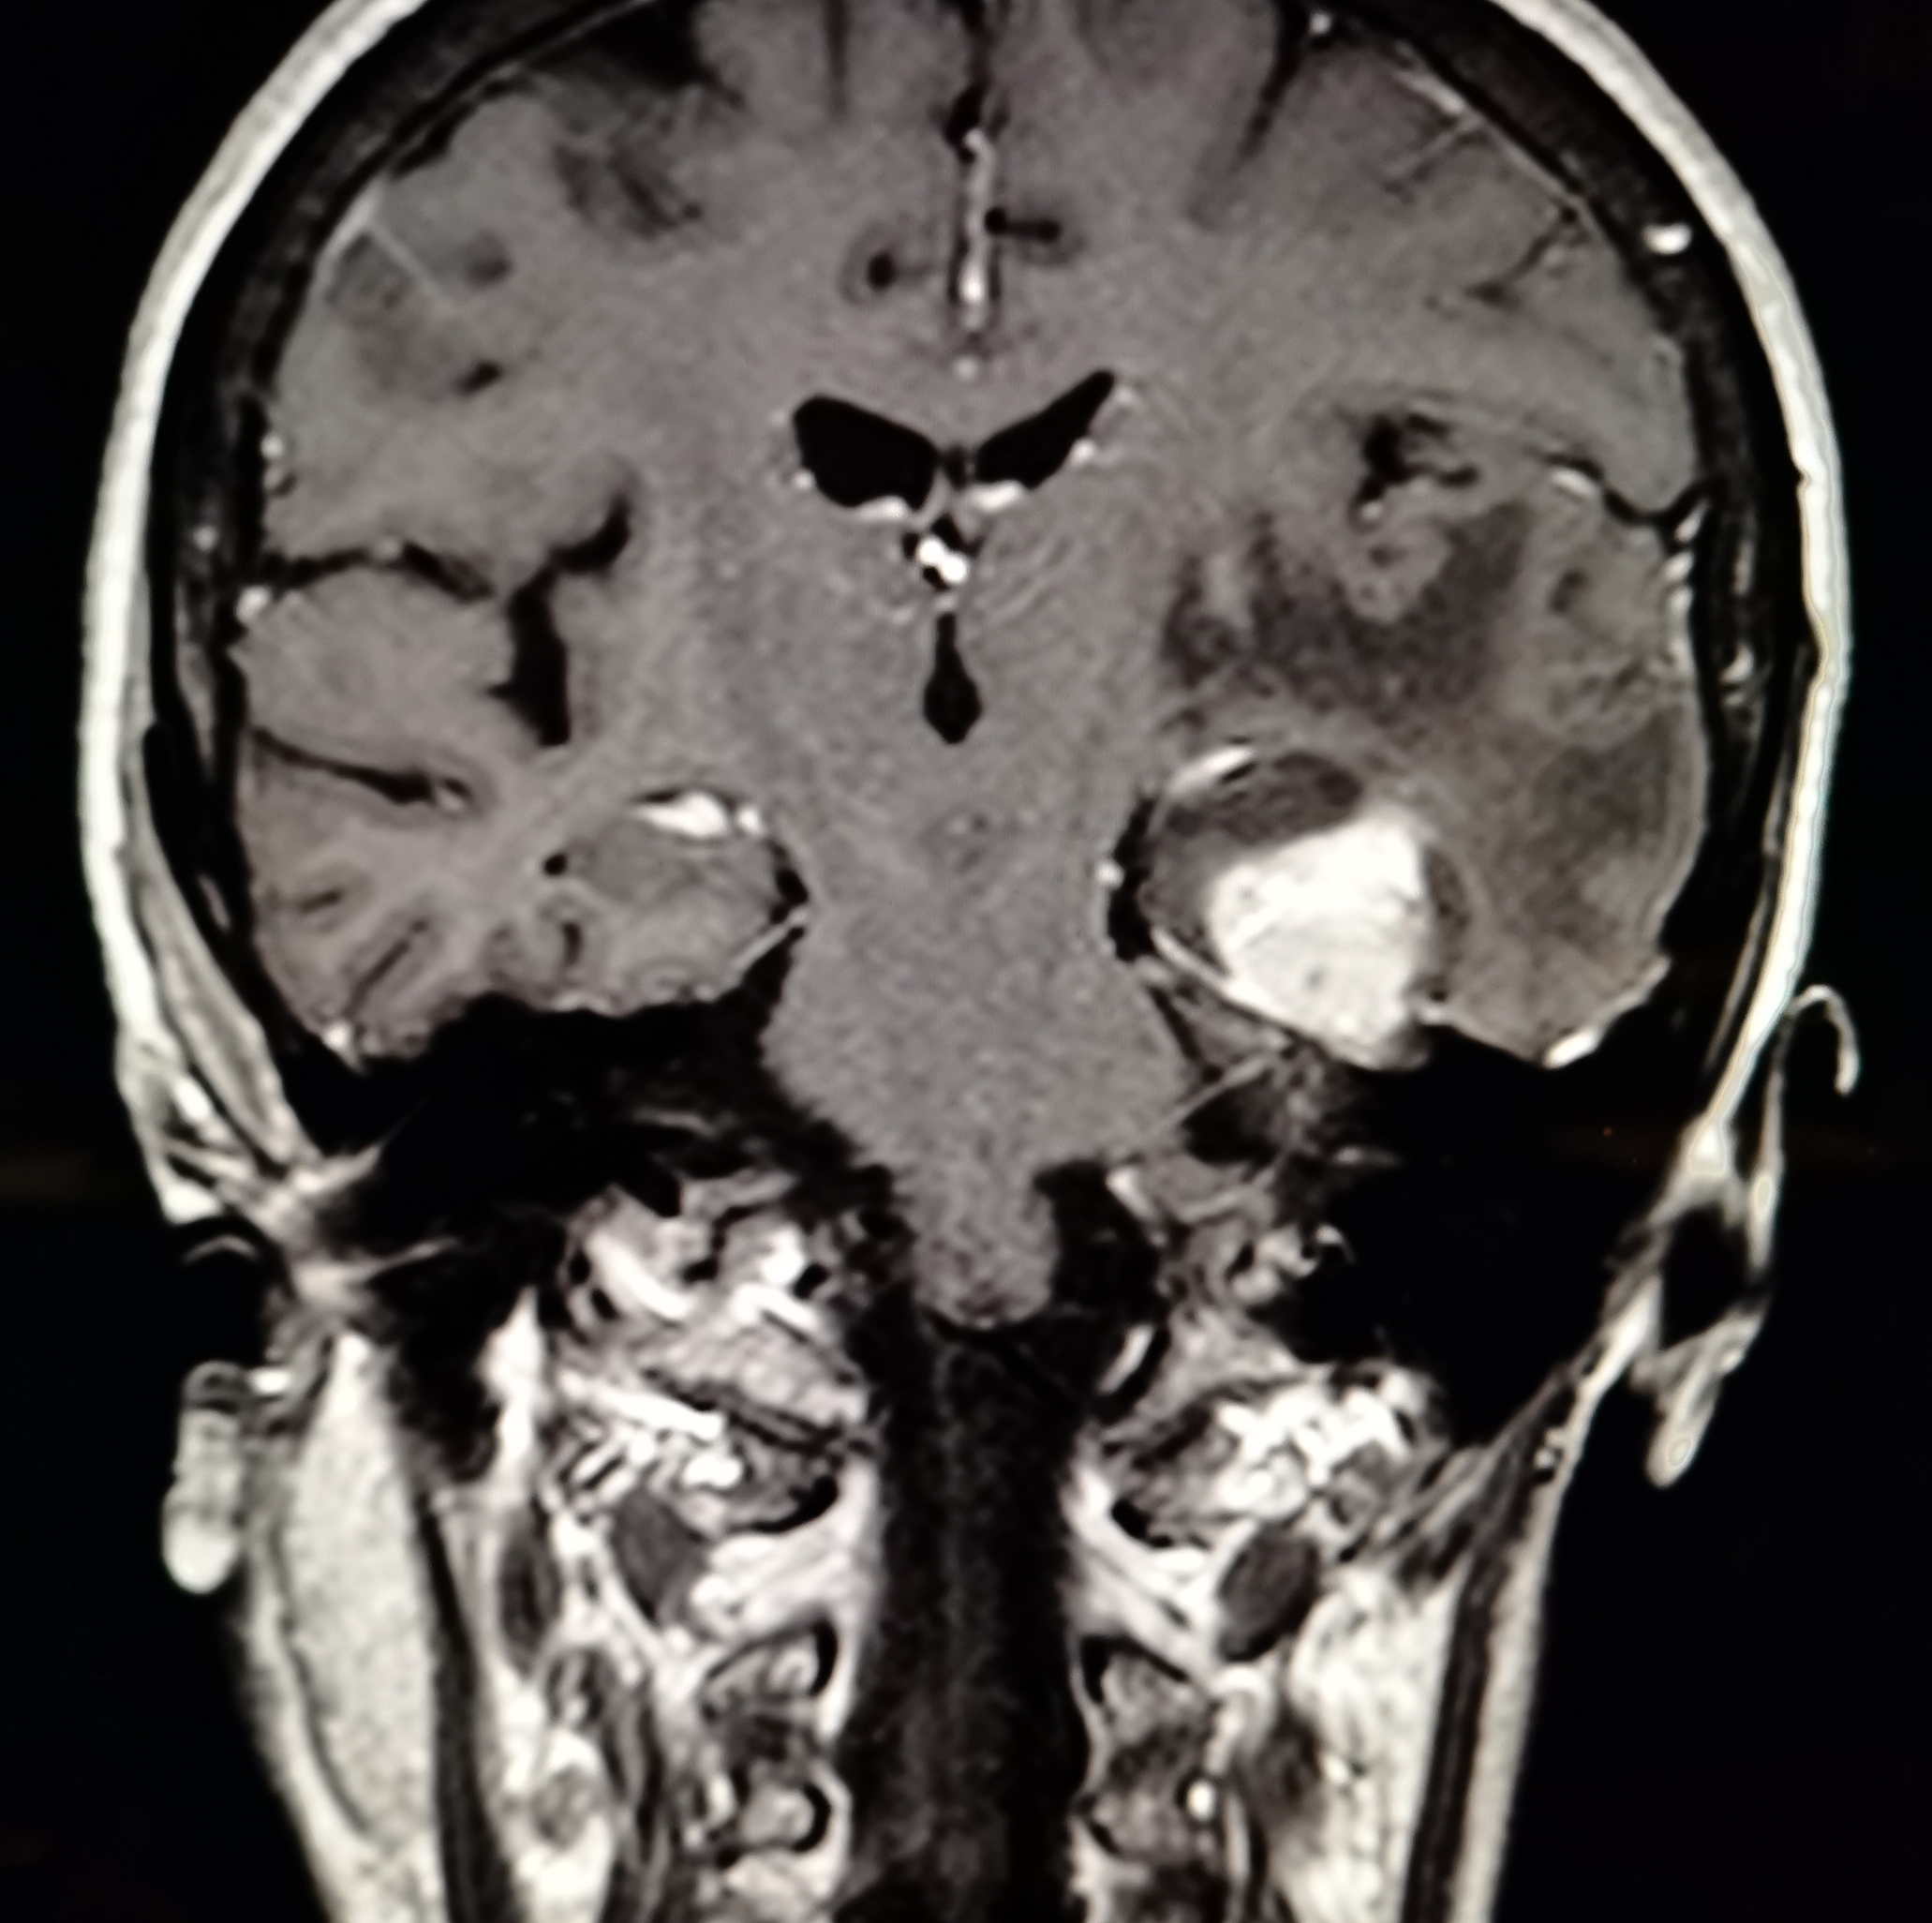
Second MRI (October 2019)

Slide 7
November 2019
Microneurosurgery at San Filippo Neri Hospital:
total removal by left subtemporal approach - middle fossa exposure.
Tumor was bloody at the base of attack on the tentorium. It had lost a clear arachnoidal cleavage with the surrounding brain. The basal temporal lobe was edematous and fragile.
Postop: uneventful, without neurological deficits

Slide 8
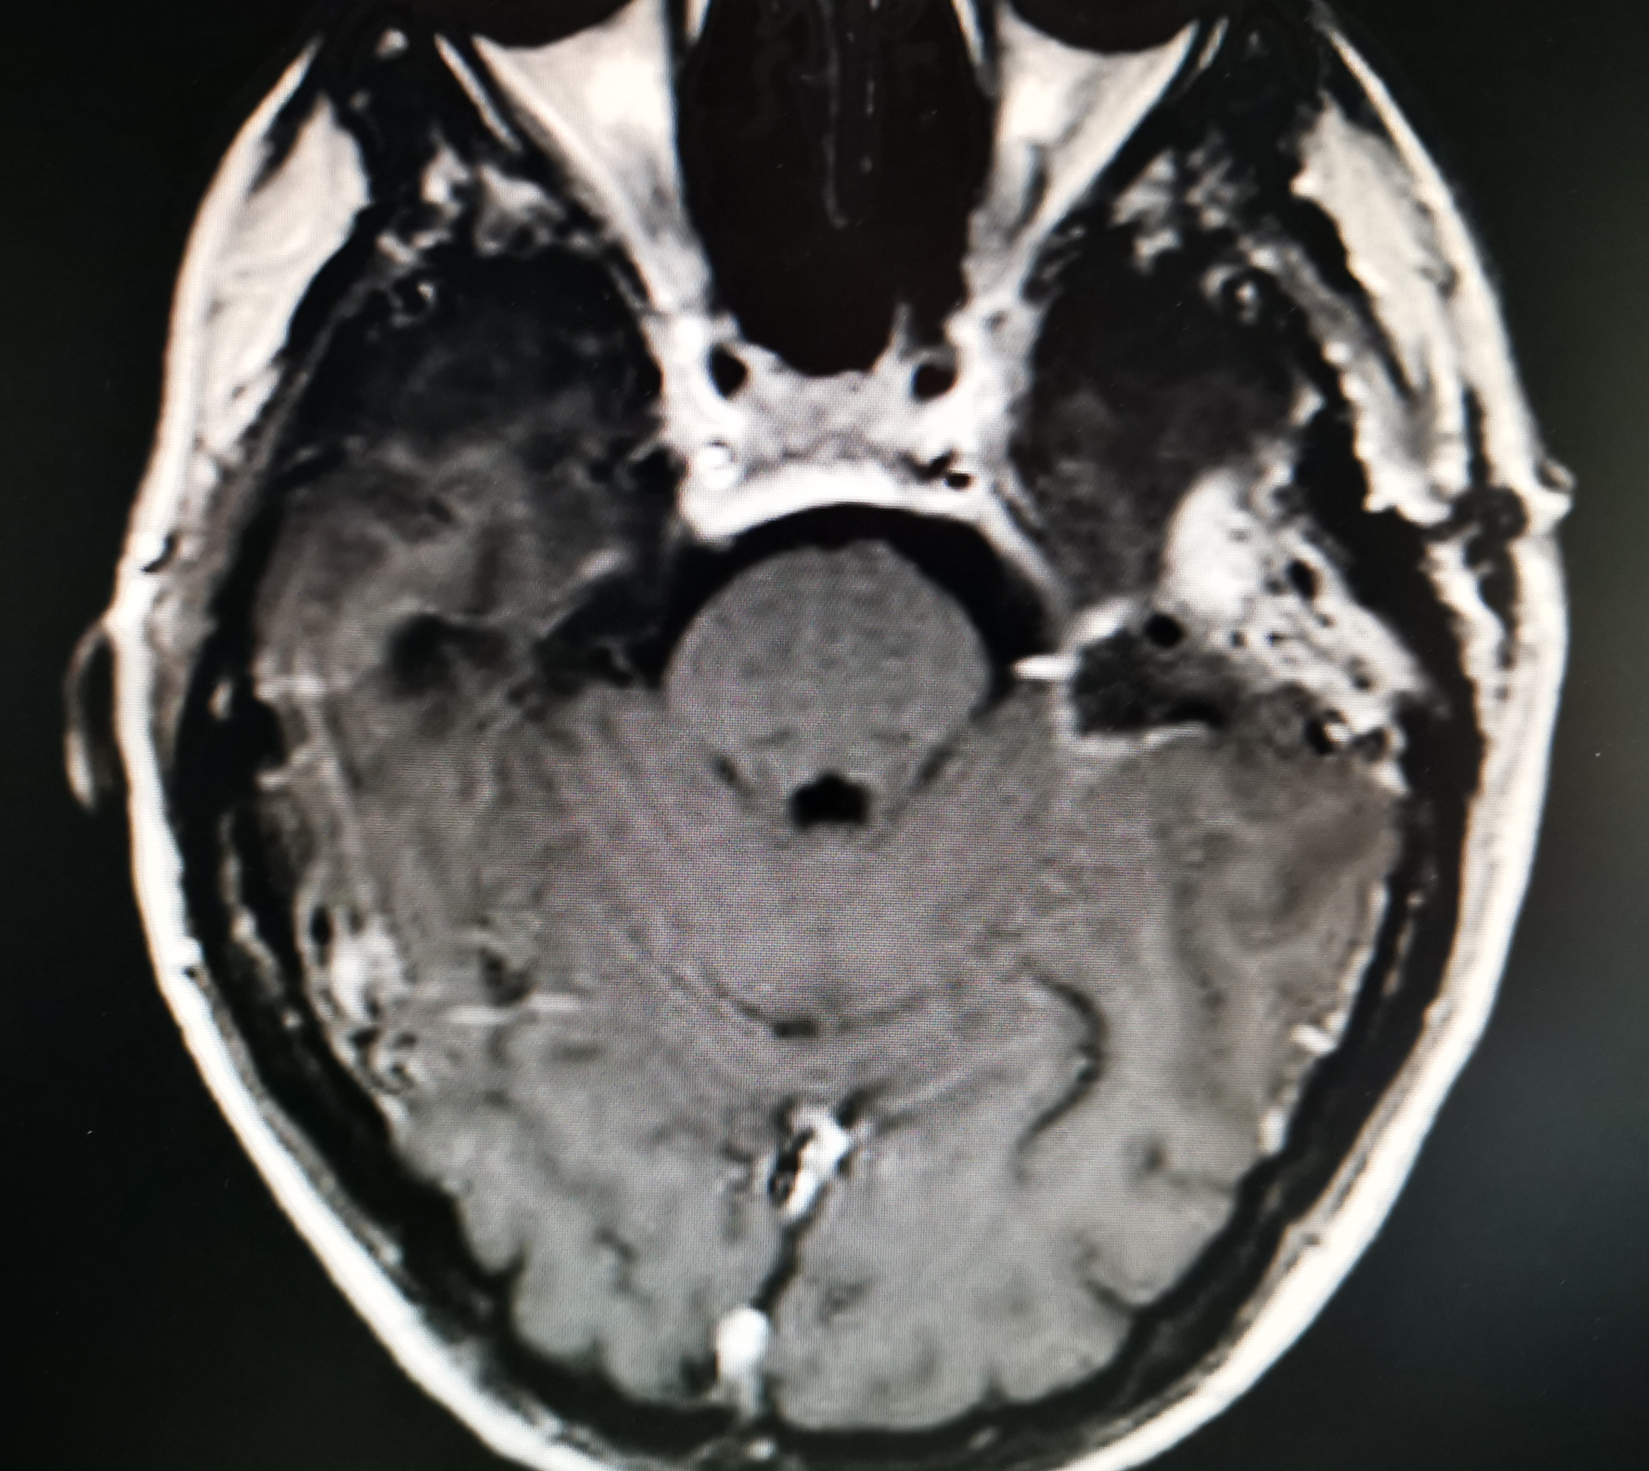
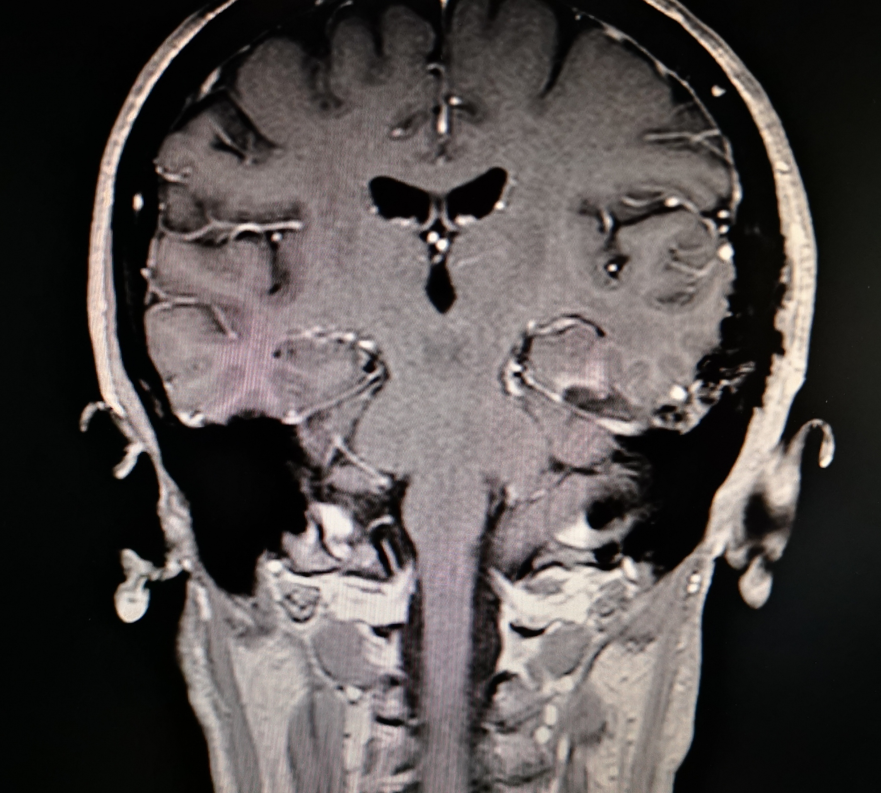
1-week Postop MRI (November 2019)

Slide 9
Conclusion
Microneurosurgery is the best treatment of intracranial meningiomas.
GK is not curative and can be dangerous for patients with resectable meningiomas.

